Slide 1
















Dimensionality Reduction Techniques

Slide 2

What is Dimensionality Reduction?
Dimensionality reduction techniques are methods used to reduce the number of variables (or dimensions) in a dataset, while preserving as much important information as possible. These techniques are particularly useful in data analysis and machine learning for several reasons

Slide 3
There are two main reasons why dimensionality reduction techniques are used:
To avoid overfitting
01.
To improve efficiency
02.

Slide 4
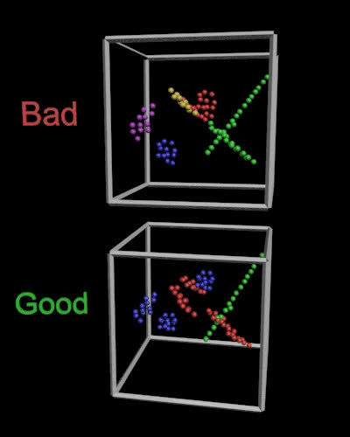
Principal Component Analysis
It's a widely used technique in machine learning and data analysis for reducing the dimensionality of data. In other words, it helps to identify a dataset's most important features or dimensions.

Slide 5
t-Distrubuted Stochastic Neighbor Embedding
t-SNE is a machine learning technique that is often used for data visualization. It allows you to take high-dimensional data and visualize it in a lower-dimensional space (usually 2D or 3D) so that you can see the relationships between different data points.

Slide 6
How They Preserve Important Information:
PCA: PCA preserves the overall variance in the data, ensuring that the most significant features (those contributing the most to the variance) are retained in the principal components.
t-SNE: t-SNE preserves the local structure of the data, meaning that points which are close together in the original high-dimensional space will also be close together in the low-dimensional embedding. This helps in visualizing clusters and patterns that exist in the data.

Slide 7
Thank you very much!

